Slide 1
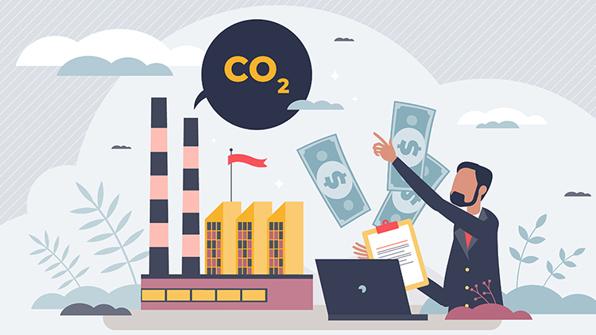

Core29 Challenge
RGU Hackathon 2024

Slide 2

Agenda
Who are we?
Challenge Introduction
Challenge Timeline
Core Objectives & Features
Further Considerations
Evaluation Criteria

Slide 3
Who are we?
Rob BI Team Manager
Alan Managing Director
Christian Project Manager

Slide 4
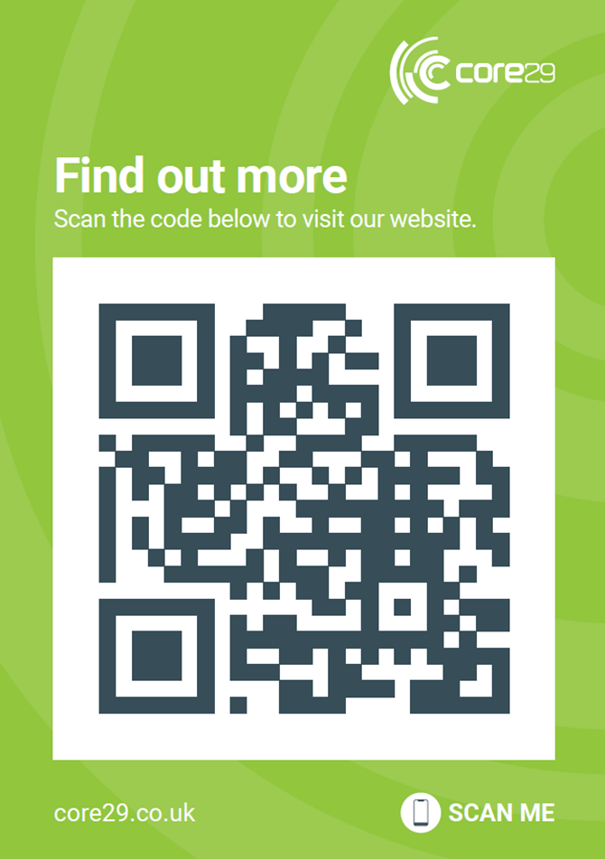
We apply technology and processes to transform business performance, helping companies deliver growth and operational efficiency.
From business analysis and strategy, to planning, design, implementation and further enhancement through Business Intelligence, we tackle the complex application of digital technology that many business even those at the cutting edge within their own sectors find daunting and outside their comfort zone.
We are leaders in identifying and applying technology and processes to transform business performance. However, we don’t believe in a one-size-fits-all approach – instead we deliver by listening to the unique needs of our customers.
We pride ourselves on really getting to know the business we are working for, walking in their shoes, looking deep into the organisation, and working with them to implement the core processes and technology that help enables them becoming high-performing, innovative and sustainable businesses. This is how we make sure the solutions are fit for the future direction of the business.

Slide 5

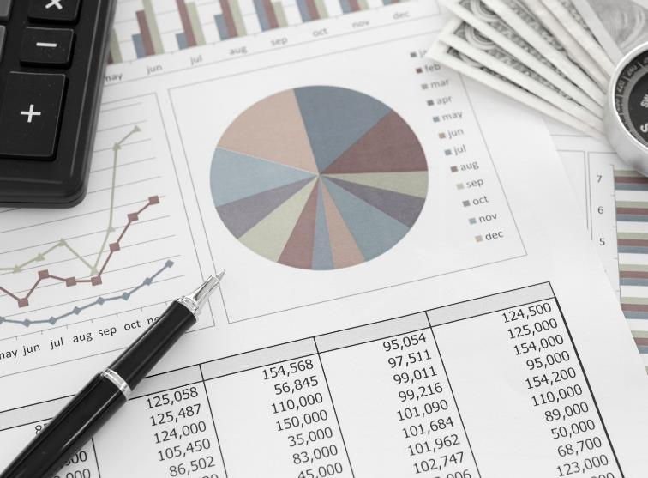
Introduction
We're thrilled to welcome you to the Core29’s Corporate Carbon Footprint Tracker Challenge. Over the next two days, you'll embark on a journey that not only challenges your innovation and creativity but also holds the potential to make a significant impact on our planet's future
The Significance of Our Challenge:
In an era where climate change poses a real and urgent threat, corporations play a pivotal role in either contributing to or alleviating this crisis. Your participation in this challenge represents a step forward in redefining how businesses approach their environmental responsibilities.

Slide 6
Challenge Timeline
Challenge Pitch
We introduce you to the challenge, its requirements and format
Discussion/ Q&A
After the pitch, you will have a chance to discuss as a team and approach us for any clarification
Build
The main component. You and your team will work over the next 24 hours to build a solution and presentation
Present
Marking and Awards
Present your solution to us and we will mark against the stated criteria
We will provide feedback for all teams and announce our winner!

Slide 7
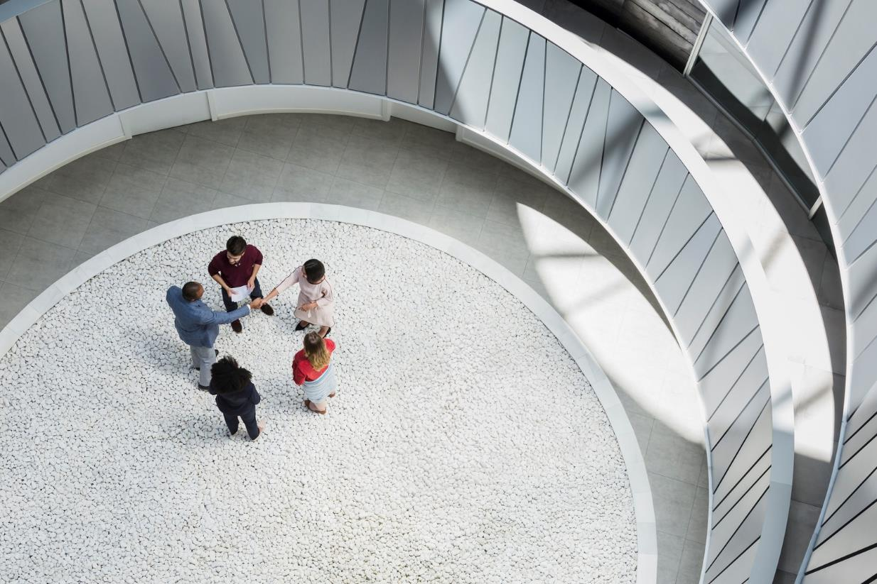
The Challenge

Slide 8
Challenge Introduction
OBJECTIVE: Design an app to track and manage corporate carbon footprints using the data provided
FOCUS AREAS: Energy Usage, Procured Items, and Employee Commuting
GOAL: Provide actionable insights to reduce environment impact
There are 3 main categories within the app. It is up to you what you choose to develop:
Energy Consumption Tracker: Monitor real-time energy usage within the business and historical data to identify trends and areas for improvement.
Total CO² of procured items: Track total embodied carbon from items procured within the business, producing insights into whether other items could be procured in place of high embodied carbon items.
Commuting Pattern Insights: Analyse employee commuting habits to suggest more sustainable alternatives and potential for remote work.

Slide 9

Further Considerations
Simplicity: Intuitive and user-friendly interface.
Accessibility: Ensure wide accessibility, including for those with disabilities.
Engagement: Find methods to ensure greater employee interaction with the app
Ease of use: Must be approachable and easy to understand
Scalable and efficient tech stack.
Paramount data privacy and security.
Scalability for growing data and user base.

Slide 10

How are we going to assess the submissions?

Slide 11

Marking Criteria
Innovation: Creativity in addressing the challenge and uniqueness of the solution.
Impact: Potential to significantly reduce corporate carbon footprints.
Usability: Ease of use, accessibility, and user engagement potential.
Design: Aesthetics, user interface, and overall user experience.
Technical Execution: Functionality, scalability, and security of the prototype.

Slide 12



Summary
This challenge offers you an opportunity to make a real difference in the fight against climate change by leveraging technology. We encourage you to think creatively, collaborate effectively, and focus on making a tangible impact through your solutions. Good luck, and let's create a sustainable future together!

Slide 13

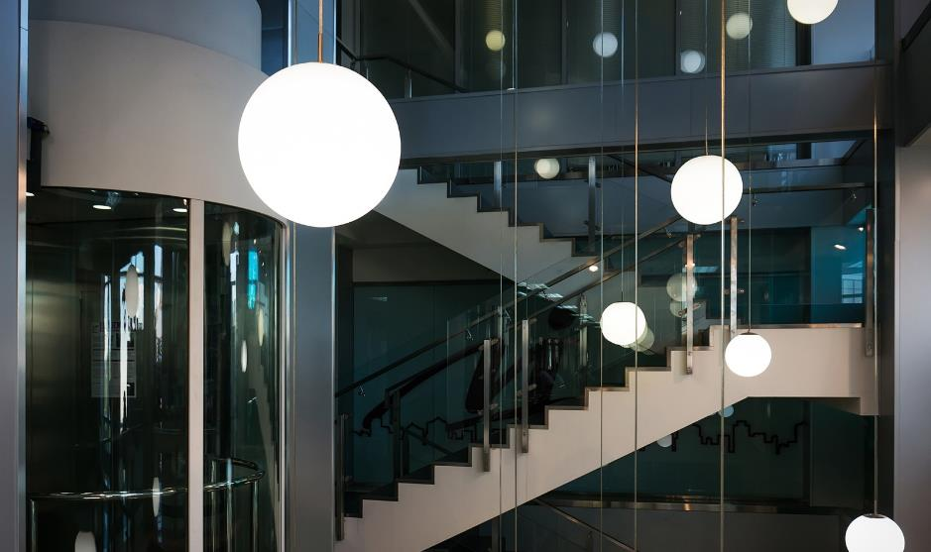
THANK YOU & GOOD LUCK!
Any questions please come find us at our stall, we look forward to hearing your ideas!

